Slide 1
Libero Tracking Clinic
based on the:
Scorekeeping Clinic

Slide 2
Officials and Work Team Common Placement
R1
L1
R1 – 1st Referee
R2 – 2nd Referee
S – Scorekeeper
LT – Libero Tracker SO – Scoreboard Operator
L1/L2 - Linesperson
L2
R2
S
Team Bench
SO
S
LT
Team Bench

Slide 3
Materials Needed to Keep Score
5 Regular score sheets (3 of 5 match)
2 line-up sheets (1 for each team)
Libero tracking sheet
2 contrasting pens (recommend Black or Blue and Red)
As the libero tracker, you only need 1 pen

Slide 4
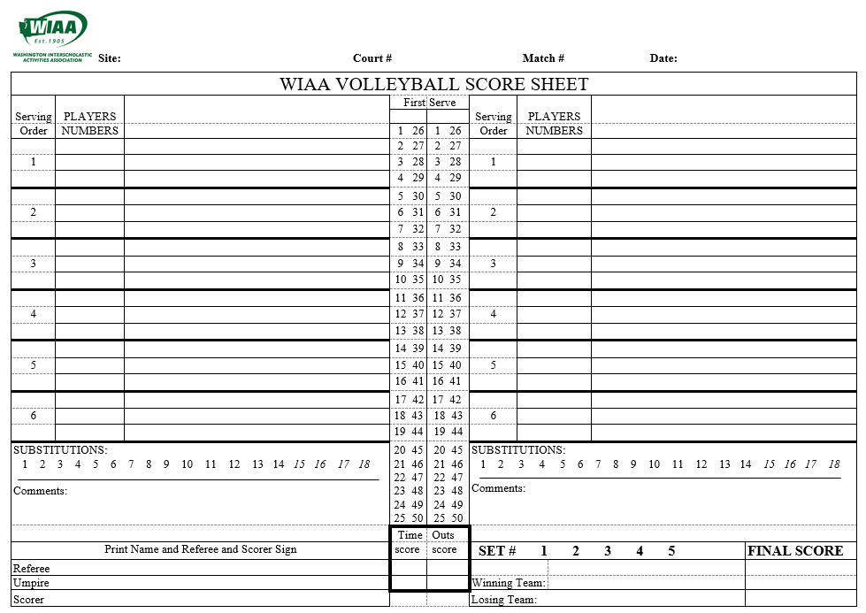
WIAA score sheet

Slide 5
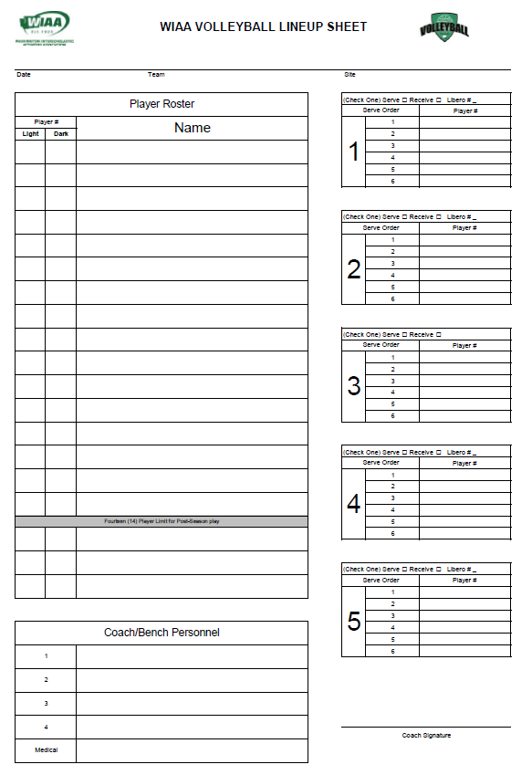

Slide 6
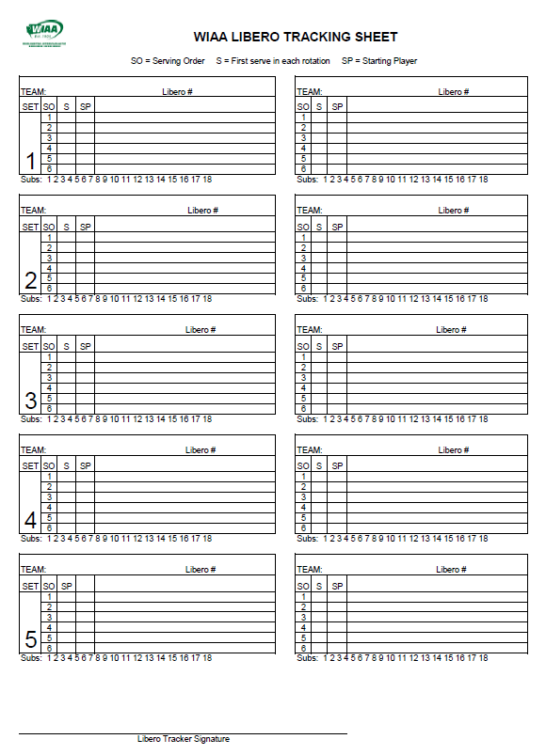

Slide 7
Instructions for the WIAA Libero Tracking Sheet
PRE-MATCH
> Write team names on the correct serving side (based on how you are viewing the court)
> Fill in starting player numbers, by serving order, for each team, under the “SP” column (captains with a “c”)
> Record the libero number for the set in the appropriate area
DURING THE GAME
> Record all substitutions as they occur
> For official substitutes:
-strike out the player leaving with a single slash and write in the new player’s number on the line next to the struck out number; strike out the count for subs underneath
> For libero replacements:
-do not strike out the player leaving for the libero; simply write an “L” next to the player number
-when the player comes back in for the libero, do not strike out the L, simply write the player number back in next to it
- you can check that correct libero replacements have been made because each one will be “#L#”
(i.e. - 3L3; if you have 3L5, it’s possible there was a mistaken replacement)
> For the libero double switch:
-if two players who are not the libero switch behind the attack line, that is a libero double switch; the player going in is going in for the libero, and the libero is going in for the player leaving
-make sure you record both replacements – put the player going in for the libero back in where the libero is currently marked, and then put the libero in for the player who came out (and is up to serve)
> Put a triangle around the number of the position the libero serves in (if they serve)
> To help the scorekeeper, you should make a tally in the column labeled “S” for each time that serving position comes up; this helps keep track of the serving order and can help you with the double switch as well (it should always occur when the position the libero serves in comes up)

Slide 8
Practice Set Situation
The following is a set situation. As you follow along with this situation you will see the placement on the libero tracking sheet. We recommend you use pencil during this session. After each situation click the mouse to see the results, then click again to move forward.

Slide 9
You arrive at Ferris HS for the match as the libero tracker. As you approach the table you see that you have all the appropriate materials to do your job.
Ferris is on your right side and Shadle Park is on your left side warming up as you are seated at the table
The lineups are turned in for both teams

Slide 10
9/11/09
Ferris
Ferris HS
x
19
1
3
1 1 Rebecca Quinn
5 c
7
3 3 Alicia Brown
9
5 5 Patty Rolf
11
7 7 Ginger Rogers
9 9 Georgia Smith
11 11 Roberta Bell
13 13 Gina Robeson
15 15 Betty Watkins
17 17 Kris Weather
19 19 Megan Moon
Coach Bob
Coach Pete
Coach Bob

Slide 11
9/11/09
Shadle Park
Ferris HS
x
20
2
4
2 2 Alicia Quinn
6 c
8
4 4 Rebecca Twin
10
6 6 Sally Green
12
8 8 Suzy Thompson
10 10 Mindy May
12 12 Yolanda Rodriguez
14 14 Patty Paige
15 15 Roberta Walker
18 18 Christina Pale
20 20 Tina Hanson
Coach Sue
Coach Mary
Coach Sue

Slide 12
Shadle Park
20
Ferris
19
2
1
4
3
6c
5c
8
7
10
9
12
11
The column marked “S” is for you to keep track of who is serving
The first time a player serves during their term of service, make a mark in that column
This allows you to track out-of-order servers, and can help you identify when libero switches will happen once you recognize the patterns

Slide 13
Shadle Park
20
Ferris
19
2
1
4
3
6c
5c
8
7
10
9
12
11
6
3
1
Libero trackers care less about the serves and points and more about who is where.
Before the set starts, the libero for Shadle Park goes in for 10.
The libero for Ferris doesn’t go in.
8
10
4
5
11
12
2
7
9
L(20)

Slide 14
Shadle Park
20
Ferris
19
2
1
4
3
6c
5c
8
7
10
L
9
12
11
6
3
1
Libero trackers care less about the serves and points and more about who is where.
Before the set starts, the libero for Shadle Park goes in for 10.
The libero for Ferris doesn’t go in.
Ferris Serves, so a mark gets made in the S column for the first server.
8
L(20)
4
5
11
12
2
7
9

Slide 15
Shadle Park
20
Ferris
19
2
1
4
3
6c
5c
8
7
10
L
9
12
11
6
3
1
Libero trackers care less about the serves and points and more about who is where.
Before the set starts, the libero for Shadle Park goes in for 10.
The libero for Ferris doesn’t go in.
Ferris Serves, so a mark gets made in the S column for the first server.
8
L(20)
4
5
11
12
2
7
9

Slide 16
Shadle Park
20
Ferris
19
2
1
4
3
6c
5c
8
7
10
L
9
12
11
6
3
1
After Ferris has lost the serve, the libero goes in for number 1.
8
L(20)
4
5
11
12
2
7
9
L(19)

Slide 17
Shadle Park
20
Ferris
19
2
1
L
4
3
6c
5c
8
7
10
L
9
12
11
6
3
L(19)
After Ferris has lost the serve, the libero goes in for number 1.
8
L(20)
4
5
11
12
2
7
9

Slide 18
Shadle Park
20
Ferris
19
2
1
L
4
3
6c
5c
8
7
10
L
9
12
11
6
3
L(19)
After Ferris has lost the serve, the libero goes in for number 1.
Shadle Park rotates 2 to the serving position.
8
L(20)
4
5
11
12
2
7
9

Slide 19
Shadle Park
20
Ferris
19
2
1
L
4
3
6c
5c
8
7
10
L
9
12
11
L(20)
8
3
L(19)
After Ferris has lost the serve, the libero goes in for number 1.
Shadle Park rotates 2 to the serving position.
12
6
5
11
2
4
7
9

Slide 20
Shadle Park
20
Ferris
19
2
1
L
4
3
6c
5c
8
7
10
L
9
12
11
L(20)
8
3
L(19)
Side out - Ferris rotates 3 to the serving position.
12
6
5
11
2
4
7
9

Slide 21
Shadle Park
20
Ferris
19
2
1
L
4
3
6c
5c
8
7
10
L
9
12
11
L(20)
8
While Ferris 3 is serving, Shadle Park calls a time out – confirm with the R2 that Liberos are IN on both sides.
5
3
12
6
7
L(19)
2
4
9
11

Slide 22
Shadle Park
20
Ferris
19
2
1
L
4
3
6c
5c
8
14
7
10
L
9
12
11
L(20)
While Ferris 3 is serving, Shadle Park calls a time out – confirm with the R2 that Liberos are IN on both sides
After time out, Shadle Park subs out 8 and puts in 14 (this will occur with a whistle between serves in front of the attack line.
5
3
12
6
7
L(19)
2
4
9
11
8
14

Slide 23
Shadle Park
20
Ferris
19
2
1
L
4
3
6c
5c
8
14
7
10
L
9
12
11
L(20)
While Ferris 3 is serving, Shadle Park calls a time out – confirm with the R2 that Liberos are IN on both sides.
After time out, Shadle Park subs out 8 and puts in 14 (this will occur with a whistle between serves in front of the attack line.
Mark the sub in the running tally below as well.
14
5
3
12
6
7
L(19)
2
4
9
11

Slide 24
Shadle Park
20
Ferris
19
2
1
L
4
3
6c
5c
8
14
7
10
L
9
12
11
L(20)
Once Ferris loses the serve and Shadle Park Rotates, 10 comes back in for the Libero.
If a player OTHER than 10 enters the set for the Libero, inform the R2.
14
5
3
12
6
7
L(19)
2
4
9
11
10

Slide 25
Shadle Park
20
Ferris
19
2
1
L
4
3
6c
5c
8
14
7
10
L
10
9
12
11
Once Ferris loses the serve and Shadle Park Rotates, 10 comes back in for the Libero.
If a player OTHER than 10 enters the set for the Libero, inform the R2.
12
10
5
3
2
14
7
L(19)
4
6
9
11

Slide 26
Shadle Park
20
Ferris
19
2
1
L
4
3
6c
5c
8
14
7
10
L
10
9
12
11
Side out – Ferris 5 back to serve.
Now that Shadle Park 4 is no longer serving, the Libero comes in to replace her.
12
10
5
3
2
14
7
L(19)
4
6
9
11
L(20)

Slide 27
Shadle Park
20
Ferris
19
2
1
L
4
L
3
6c
5c
8
14
7
10
L
10
9
12
11
Side out – Ferris 5 back to serve.
Now that Shadle Park 4 is no longer serving, the Libero comes in to replace her.
12
10
7
5
2
14
9
3
L(20)
6
11
L(19)

Slide 28
Shadle Park
20
Ferris
19
2
1
L
4
L
3
6c
5c
8
14
7
10
L
10
9
12
11
Side out – Shadle Park 6 back to serve.
12
10
7
5
2
14
9
3
L(20)
6
11
L(19)

Slide 29
Shadle Park
20
Ferris
19
2
1
L
4
L
3
6c
5c
8
14
7
10
L
10
9
12
11
Side out – Shadle Park 6 back to serve.
2
12
7
5
L(20)
10
9
3
6
14
11
L(19)

Slide 30
Shadle Park
20
Ferris
19
2
1
L
4
L
3
6c
5c
8
14
7
10
L
10
9
12
11
Side out – Ferris 7 up to serve.
BUT 7 and 1 replace behind the attack line & Libero goes to serve.
This is the Double Replacement; technically, 1 comes in for the Libero and the Libero leaves, then immediately comes back in for 7.
2
12
7
5
L(20)
10
9
3
6
14
11
L(19)
1

Slide 31
Shadle Park
20
Ferris
19
2
1
L
4
L
3
6c
5c
8
14
7
10
L
10
9
12
11
7
Side out – Ferris 7 up to serve.
BUT 7 and 1 replace behind the attack line & Libero goes to serve.
This is the Double Replacement; technically, 1 comes in for the Libero and the Libero leaves, then immediately comes in for 7.
2
12
9
L(20)
10
11
5
6
14
1
3
L(19)
**This is the step that gets skipped to save time

Slide 32
Shadle Park
20
Ferris
19
2
1
1
L
4
L
3
6c
5c
8
14
7
L
10
L
10
9
12
11
Side out – Ferris 7 up to serve.
BUT 7 and 1 replace behind the attack line & Libero goes to serve.
This is the Double Replacement; technically, 1 comes in for the Libero and the Libero leaves, then immediately comes in for 7.
2
12
9
L(19)
L(20)
10
11
5
6
14
1
3

Slide 33
Shadle Park
20
Ferris
19
2
1
1
L
4
L
3
6c
5c
8
14
7
L
10
L
10
9
12
11
The Libero serves from this position, so a Triangle is put around the 4th spot in the serving order.
If the libero serves from any other serving position, inform the R2.
2
12
9
L(19)
L(20)
10
11
5
6
14
1
3

Slide 34
Shadle Park
20
Ferris
19
2
1
1
L
4
L
3
6c
5c
8
14
7
L
10
L
10
9
12
11
Side Out – Shadle Park 14 back to serve.
2
12
9
L(19)
L(20)
10
11
5
6
14
1
3

Slide 35
Shadle Park
20
Ferris
19
2
1
1
L
4
L
3
6c
5c
8
14
7
L
10
L
10
9
12
11
Side Out – Shadle Park 14 back to serve.
L(20)
2
9
L(19)
6
12
11
5
14
10
1
3

Slide 36
Shadle Park
20
Ferris
19
2
1
1
L
4
L
3
6c
5c
8
14
7
L
10
L
10
9
12
11
Side Out – Ferris 9 back to serve, but both teams want subs – this happens with a whistle.
L(20)
2
9
L(19)
6
12
11
5
14
10
1
3

Slide 37
Shadle Park
20
Ferris
19
2
1
1
L
4
L
3
6c
5c
8
14
7
L
10
L
10
9
12
11
Side Out – Ferris 9 back to serve, but both teams want subs – this happens with a whistle.
Shadle Park subs 8 back in for 14.
Ferris subs 13 for 9.
L(20)
2
11
6
12
1
L(19)
10
3
14
9
5
8
13

Slide 38
Shadle Park
20
Ferris
19
2
1
1
L
4
L
3
6c
5c
8
14
8
7
L
10
L
10
9
13
12
11
Side Out – Ferris 9 back to serve, but both teams want subs – this happens with a whistle.
Shadle Park subs 8 back in for 14.
Ferris subs 13 for 9.
L(20)
2
11
13
6
12
1
L(19)
8
10
3
5

Slide 39
Shadle Park
20
Ferris
19
2
1
1
L
4
L
3
6c
5c
8
14
8
7
L
10
L
10
9
13
12
11
Side Out – Ferris 9 back to serve, but both teams want subs – this happens with a whistle.
Shadle Park subs 8 back in for 14.
Ferris subs 13 for 9.
Don’t forget to mark the subs!
L(20)
2
11
13
6
12
1
L(19)
8
10
3
5

Slide 40
Shadle Park
20
Ferris
19
2
1
1
L
4
L
3
6c
5c
8
14
8
7
L
10
L
10
9
13
12
11
Side Out – Shadle Park 10 back to serve.
4 replaces the Libero.
L(20)
2
11
13
6
12
1
L(19)
8
10
3
5
4

Slide 41
Shadle Park
20
Ferris
19
2
1
1
L
4
L
4
3
6c
5c
8
14
8
7
L
10
L
10
9
13
12
11
Side Out – Shadle Park 10 back to serve.
4 replaces the Libero.
6
4
11
13
8
2
1
L(19)
10
3
12
5

Slide 42
Shadle Park
20
Ferris
19
2
1
1
L
4
L
4
3
6c
5c
8
14
8
7
L
10
L
10
9
13
12
11
Side Out – Ferris 11 back to serve.
Shadle Park Libero replaces 10.
6
4
11
13
8
2
1
L(19)
10
3
12
5
L(20)

Slide 43
Shadle Park
20
Ferris
19
2
1
1
L
4
L
4
3
6c
5c
8
14
8
7
L
10
L
10
9
L
13
12
11
Side Out – Ferris 11 back to serve.
Shadle Park Libero replaces 10.
6
4
1
11
8
2
3
13
L(20)
5
L(19)
12

Slide 44
Shadle Park
20
Ferris
19
2
1
1
L
4
L
4
3
6c
5c
8
14
8
7
L
10
L
10
9
L
13
12
11
Side Out – Shadle Park 12 back to serve.
6
4
1
11
8
2
3
13
L(20)
5
L(19)
12

Slide 45
Shadle Park
20
Ferris
19
2
1
1
L
4
L
4
3
6c
5c
8
14
8
7
L
10
L
10
9
L
13
12
11
Side Out – Shadle Park 12 back to serve.
8
6
1
11
L(20)
4
3
13
12
2
5
L(19)

Slide 46
Shadle Park
20
Ferris
19
2
1
1
L
4
L
4
3
6c
5c
8
14
8
7
L
10
L
10
9
L
13
12
11
Side Out – Ferris 1 back to serve.
Shadle Park 7 replaces Libero.
8
6
1
11
L(20)
4
3
13
12
2
5
L(19)
7

Slide 47
Shadle Park
20
Ferris
19
2
1
1
L
4
L
4
3
6c
5c
8
14
8
7
L
7
10
L
10
9
L
13
12
11
Side Out – Ferris 1 back to serve.
Shadle Park 7 replaces Libero.
8
6
3
1
L(20)
4
5
11
12
2
7
13

Slide 48
Shadle Park
20
Ferris
19
2
1
1
L
4
L
4
3
6c
5c
8
14
8
7
L
7
10
L
10
9
L
13
12
11
Side Out – Shadle Park 2 back to serve.
Ferris Libero replaces 1.
8
6
3
1
L(20)
4
5
11
12
2
7
13
L(19)

Slide 49
Shadle Park
20
Ferris
19
2
1
1
L
L
4
L
4
3
6c
5c
8
14
8
7
L
7
10
L
10
9
L
13
12
11
Side Out – Shadle Park 2 back to serve.
Ferris Libero replaces 1.
L(20)
8
3
L(19)
12
6
5
11
2
4
7
13

Slide 50
Shadle Park
20
Ferris
19
2
1
1
L
L
4
L
4
3
6c
5c
8
14
8
7
L
7
10
L
10
9
L
13
12
11
Set finishes while Shadle Park 2 serves.
L(20)
8
3
L(19)
12
6
5
11
2
4
7
13

Slide 51
SUMMARY and TIPS
Keep your eyes up! Libero replacements happen without a whistle, so you need to see them happen
Track the first time a play serves in the “S” column
Substitutes are slashed, libero replacements are not
Track the total number of subs below the box for each team
Put a triangle around the position the libero serves from
Inform the R2 as soon as possible during a dead ball (before the beckon for serve or after the rally– not during play) if:
The libero serves from a different position than the triangle
The wrong player comes back in for the libero
You notice a player’s number listed on multiple lines (you can verify this with the scorer, too)

